Slide 1
Comparative Analysis of Distributed STORAGE sYSTEMS
GROUP - 11
Harsh Vora(A20445400)
Nishant Pathare(A20444988)
Sathyaveer Karmarkar(A20445690)

Slide 2
Motivation
Centralized databases disadvantages:
Single point of failure.
Bottleneck on IO or CPU.
Not flexible enough for high scale computing.
Relational database : Relational model is not flexible.
Key-value stores can easily be used by other applications (e.g. ZHT).

Slide 3
Motivation
Motivations to evaluate various Key-Value Storage Systems
To compare and contrast the three distributed Key/Value Storage Systems(Cassandra, Redis, MongoDB) with ZHT.
To find which storage system provide good throughput and latency on various physical nodes.
To observe which of the storage systems provide simple implementation of Distributed Key-Value Pairs.

Slide 4
Proposed Work
Compare throughput and latency performance of three NoSQL systems on insert, lookup, and delete operations:
Cassandra
MongoDB
Redis
Deploy each system over 8 m1.medium instances.
Scale the nodes executing concurrent 100K requests from 1 to 8.
Compute throughput in Ops/sec and latency in ms.
Visualize the results to know which system provides the best throughput, the lowest latency.

Slide 5
Cassandra, mongodb, redis
Apache Cassandra is distributed and wide column NoSql database. It is written in Java. All nodes in cassandra cluster are peers and there is no master-slave paradigm in Cassandra. This makes cassandra highly available, fault tolerant and no-single point of failure. Cassandra clusters can be scaled horizontally and can be distributed to multiple data centers.
MongoDB is a cross-platform, document-oriented, highly available, scalable, and flexible NoSql database written in C++. It works on collections and documents and provides high availability through replica sets.
Redis is a scalable data store, which can be used as a database, cache, and also as a message broker.

Slide 6
Evaluation
We have compared the performance( via throughput and latency) of three NoSQL database systems over three operations: insert, lookup, and delete.

Slide 7
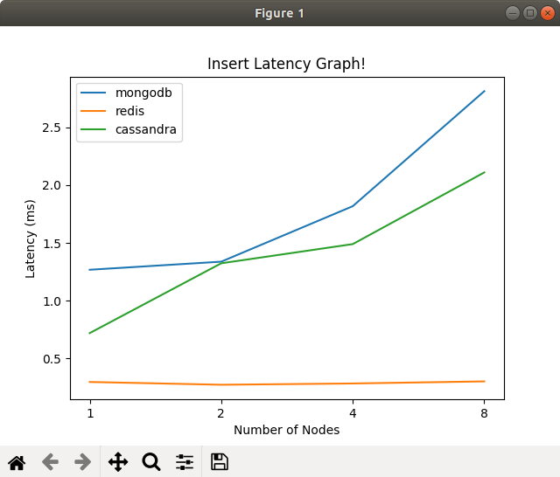
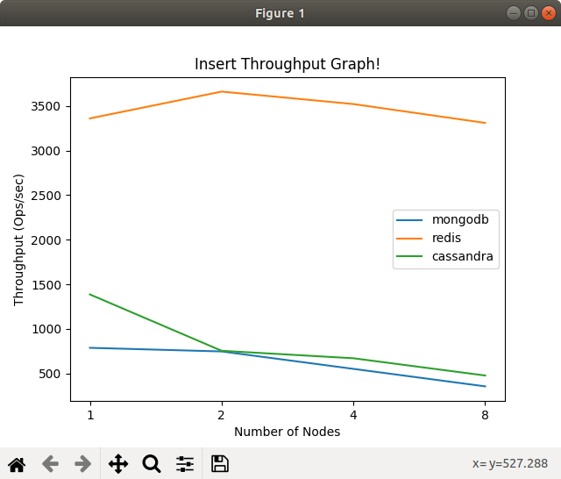
Insert Operation

Slide 8
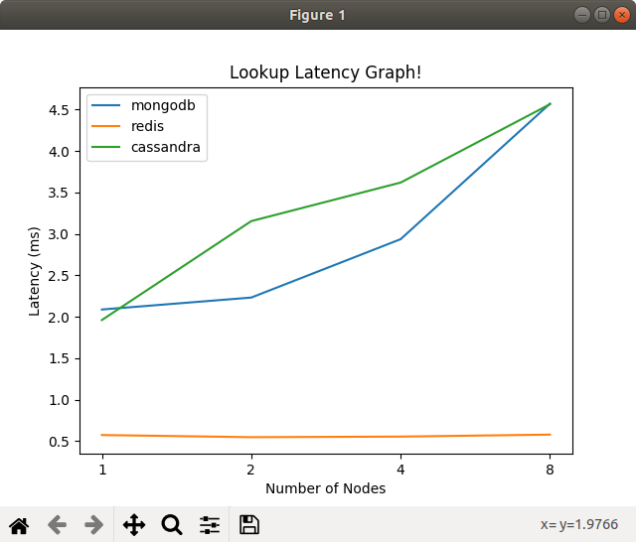
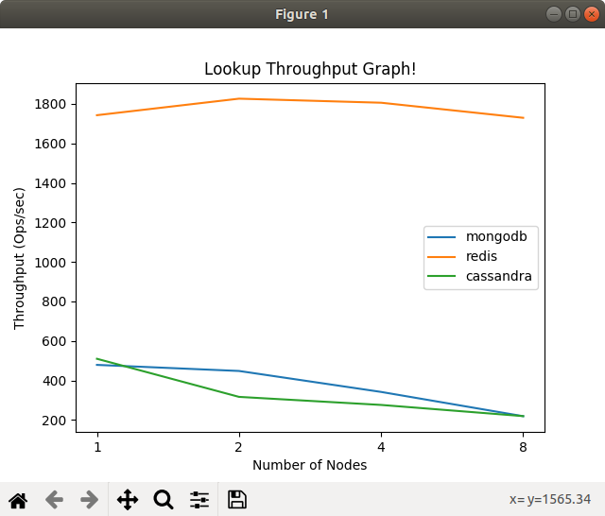
Lookup Operation

Slide 9
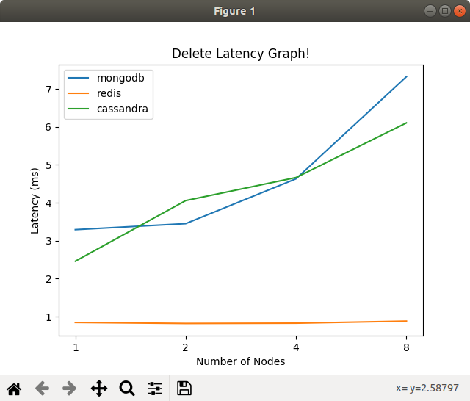
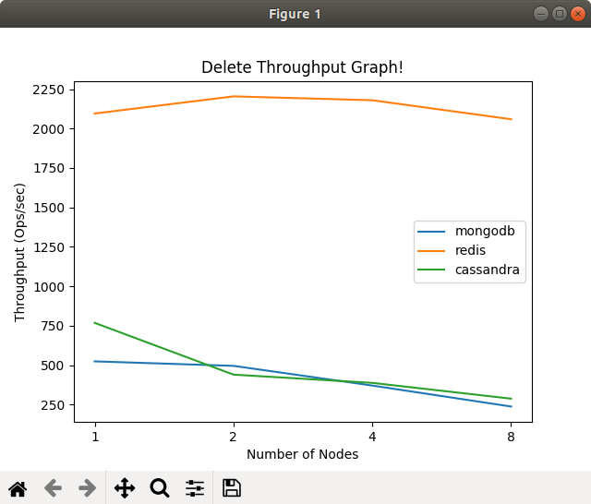
Delete Operation

Slide 10
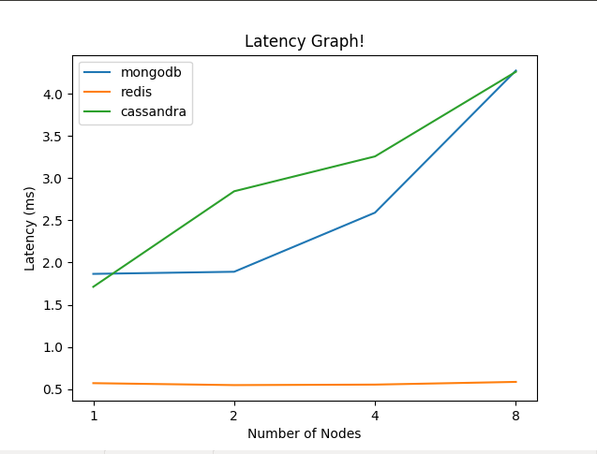
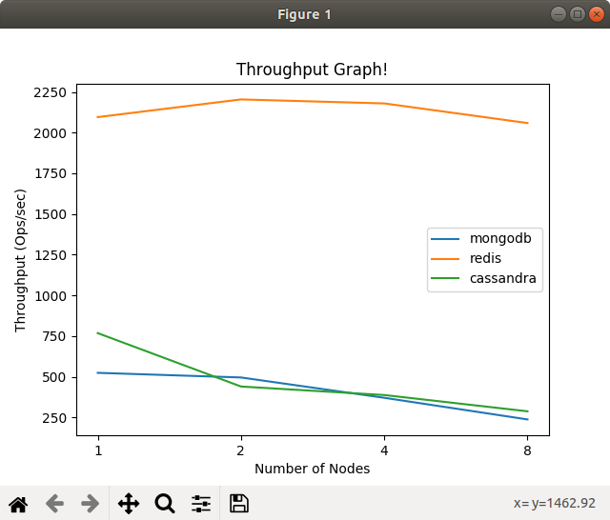
Average of 3 operations

Slide 11
Conclusion
After evaluating the three systems on chameleon, we notice that Redis is the most scalable system overall. Redis is an in-memory data store that can persist its state to disk, which can recover its state even after restart of Redis nodes. Therefore, on small key-value pairs, it seems coherent that this system performs the best.
On the other hand, Cassandra and mongoDB are more robust to failures as well as best fitted for handling large amount of data.

Slide 12
References
Tonglin Li , Xiaobing Zhou , Kevin Brandstatter, Dongfang Zhao , Ke Wang , Anupam Rajendran, Zhao Zhang , Ioan Raicu. “ZHT: A Light-weight Reliable Persistent Dynamic Scalable Zero-hop Distributed Hash Table” .
Cassandra http://cassandra.apache.org
Redis http://redis.io
MongoDB https://www.mongodb.org
https://www.javacodegeeks.com/2019/02/nosql-databases-cassandra-vs-mongo-vs-redis-db-comparison.html

